Slide 1
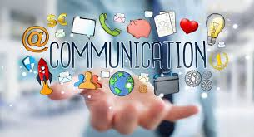
INTRODUCTION TO COMMUNICATION SKILLS
AYEBAZIBWE JENIFER

Slide 2
Content
Defining communication
Communication process
Communication components

Slide 3
Definition
Theodorson & Theodorson (1969)
Communication is defined as the transmission of information, ideas, attitudes, and or emotions from one person or group
of people to another person or group of people.
In other words,
Communication is the process by which a message or information is exchanged between a sender and a receiver.

Slide 4
PROCESS OF COMMINCATION
Process
5.
Feedback
Travels to sender
(Responding)
1.
Sender has
idea
2.
Sender encodes
Idea into a message
3.
Message travels
Over channel
4.
Receiver decodes
message
5.
Possible additional
Feedback to receiver

Slide 5
PROCESS OF COMMINCATION
Process
Your friend responds with “ yes, I would love to come!”(Responding)
You think of inviting your friend to a party(sender has an idea)
You write a text message saying hey want to come to come to my party on Saturday?(encoding)
You send the text message through your phone (channel)
Your friend reads the message and understands the invitation(decodes)
Great, I will send you the details.(possible additional feedback to the receiver

Slide 6
COMMUNICATION PROCESSES DES..
Ideation
Formation of the idea or selection of message to be communicated.
Consists of what is to be communicated (concern and content to be presented).
It’s a stage where the sender having an idea they want to convey. This is the starting point of the communication process.

Slide 7
PROCESS OF COMMINCATION
Encoding
This refers to the process of converting an idea or thought into a message
The sender translates their thoughts into words, symbols, signals that can be transmitted to the receiver
So when you write a text message or speak, you are encoding your thoughts into words

Slide 8
PROCESS OF COMMINCATION
Decoding
This is the process of interpreting the message by the receiver.
This receiver takes the words, symbols, signals and translates them back into meaning.
The receiver tried to understand the message based on their knowledge, experiences and context
Example
When someone reads your message and understands what you are saying then, they are decoding the message

Slide 9
COMMUNICATION PROCESSES DES..
Transmission
This refers to the process of sending the message through a channel or medium or channel.
Examples
Verbal communication(face to face, phone calls, video conferencing)
Non verbal communication(body language, facial expressions)
Written communication(emails, texts, letters)
Visual communication(images, videos, presentations)

Slide 10
COMMUNICATION PROCESSES DES..
Response/ feedback stage
This is where receiver responds to the message
- Action or reaction of the receiver to the message.
- Helps the sender to know that the message was received and understood.
–This is key for effective communication.
It can be verbal(verbal response)
Non verbal(body language, facial expressions)
Written feedback(email, text, message)

Slide 11
COMMUNICATION COMPONENTS
Verbal Message
The words chosen for communication.
Para verbal Message
How the chosen words are said/communicated.
Nonverbal Message
Body language while saying the chosen words for communication.
These three components are used to;
Send clear, concise message
Receive and correctly understand messages sent to receiver.

Slide 12
COMMUNICATION COMPONENTS
Verbal Message
Verbal messages refer to the use of words, either spoken or written, to convey meaning and information.
Examples of verbal messages
Face-to-face conversations
Phone calls
Video conferencing
Written messages (emails, texts, letters)
Presentations
Meetings

Slide 13
COMMUNICATION COMPONENTS
Verbal communication can be formal (in form of official reports, speeches) or informal(casual conversations, social media posts)
Effective verbal communication involves:
Clear and concise language
Active listening
Appropriate tone and pitch
Awareness of nonverbal cues (body language, facial expressions)
5. No jargons (easy to understand)
It should be respectful and engaging (don't push people away)
This helps ensure your message is heard and understood.

Slide 14
COMMUNICATION COMPONENTS
Nonverbal messages
Nonverbal messages are forms of communication that don't involve words.
They can convey meaning and emotions through:
Body language (posture, gestures, facial expressions)
Eye contact
Tone of voice (pitch, volume, pace)
Proximity (physical distance)
Touch (physical contact)
Appearance (clothing, grooming “personal hygiene, hair care, clothing and attire, or overall appearance (nails, make up)
Notes:
1. Personal hygiene (cleanliness, showering, etc.)2. Hair care (styling, trimming, etc.)3. Clothing and attire (dressing appropriately)4. Overall physical appearance (nails, makeup, etc.)

Slide 15

COMMUNICATION COMPONENTS
Non verbal communication can;
Support or contradict what you say
Show how you feel
Impact how others interact with you
Examples of non verbal communication
Nodding to show agreement
Frowning to show disapproval
Leaning forward to show engagement
Avoiding eye contact to show nervousness or dishonesty
Standing up straight to show confidence
Using open and relaxed body language to show approachability
Non verbal communication speaks louder than verbal

Slide 16
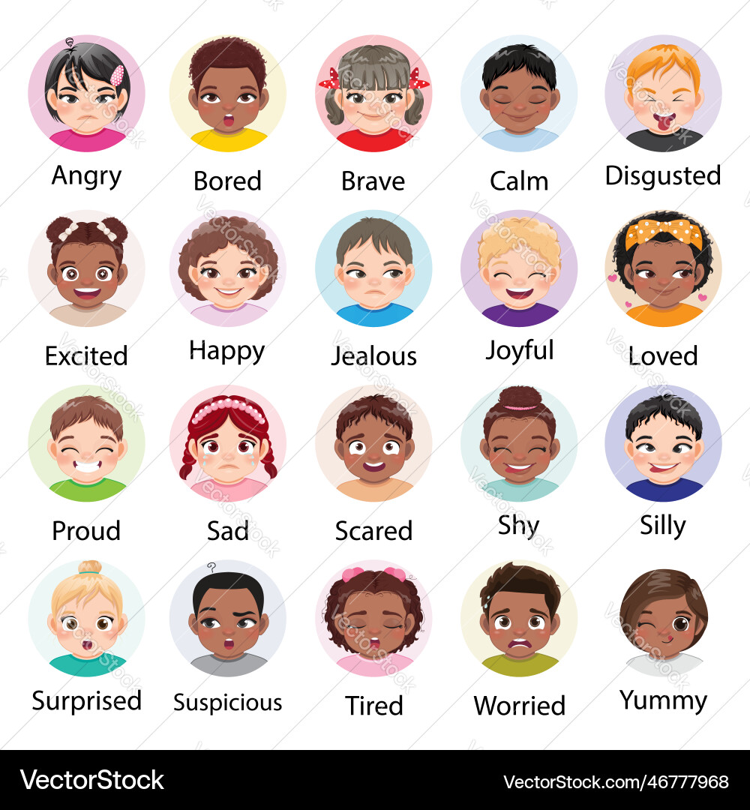

Slide 17
COMMUNICATION COMPONENTS
Paraverbal messages
This refers to the way you say something, beyond the actual words.
It includes:
Tone of voice
Pitch
Volume
Pace
Pauses

Slide 18
COMMUNICATION COMPONENTS
Paraverbal cues can convey emotions, attitudes, and intentions, and can greatly impact how your message is received.
For example:
A sarcastic tone can convey opposite meaning(Wowwwww, thanks for coming)
A soft tone can convey empathy
A loud tone can convey urgency or anger
It's not just what you say, but how you say it!

Slide 19
CLASSIFICATION/LEVELS OF COMMUNICATION
Communication is best classified as;
Intrapersonal Communication
Interpersonal Communication
Personal Communication
Extra-personal Communication
And in terms of group size
Small Group Communication
Larger Group/External Communication
Mass Communication

Slide 20
CLASSIFICATION/LEVELS OF COMMUNICATION
Intrapersonal communication
This is the inner conversation you have with yourself, including thoughts, feelings, and reflections.
It's your internal dialogue, self-talk, and introspection that helps you:
1. Understand yourself
2. Make decisions
3. Solve problems
4. Manage emotions
Intrapersonal communication involves only one person, with the sender and receiver being the same
Examples include rehearsing a conversation in your head before a meeting, analyzing a past mistake, or simply daydreaming.

Slide 21
CLASSIFICATION/LEVELS OF COMMUNICATION
Interpersonal communication
Interpersonal communication is the exchange of information, ideas, and feelings between two or more people.
It involves:
Verbal and nonverbal cues
Active listening
Feedback and response
Building relationships and rapport
Interpersonal communication can occur in various settings, such as:
1.Personal relationships (friends, family)
2. Professional settings (workplace, meetings)
3. Social interactions

Slide 22
CLASSIFICATION/LEVELS OF COMMUNICATION
Personal communication
Personal communication typically refers to informal, direct interactions between individuals, often in a personal or social context.
This can include:
Conversations with friends and family
Emails or messages to loved ones
Phone calls or text messages
Social media interactions with friends
Personal communication is often characterized by:
1. Informal tone
2. Personal topics
3. Emotional connection

Slide 23
CLASSIFICATION/LEVELS OF COMMUNICATION
Extra personal communication
This refers to communication that occurs outside of personal relationships or direct human interaction.
It can also mean interactions between a human and a non-human entity, such as training a pet, communicating with a robot, or even a plant's response to touch.
This can include:
Mass media(TV, radio, news papers)
Public speeches
Advertisements
Social media broadcasts
Public service announcements
Billboards
Extra personal communication involves a larger audience and lacks the immediacy and interactivity of interpersonal communication.

Slide 24
CLASSIFICATION/LEVELS OF COMMUNICATION
Small group communication
This is the type of communication which involves 3+(usually between 3-15) people working together, sharing a common goal, and influencing each other to achieve it.
Examples: team meetings, study groups, committee discussions, project groups, focus groups.
Key aspects include:
Collaborative effort
Shared purpose
Mutual influence
Interdependent relationships

Slide 25
CLASSIFICATION/LEVELS OF COMMUNICATION
Large group/ external communication
In this kind of communication, organizations communicate externally to share information with outsiders, like customers, suppliers, and the public. This helps build relationships, enhance reputation, and drive business growth through channels like ads, social media, and press releases.
Examples of large group/external communication:
Company advertisements on TV or social media
Press releases announcing new products or services
Social media campaigns targeting customers
Annual reports to shareholders
Public speeches by CEOs or organizational leaders

Slide 26
CLASSIFICATION/LEVELS OF COMMUNICATION
Mass communication
This is the process of creating and distributing messages to large, often anonymous, and diverse audiences through mass media channels like television, radio, newspapers, the internet, and social media.
Examples of mass media communication:
News broadcasts on TV (e.g., CNN, BBC, NTV Uganda, NBS)
Newspaper articles (e.g., The New York Times, New vision, Daily monitor)
Radio shows (e.g., podcasts, talk radio)
Social media posts (e.g., Twitter, Facebook)
Magazines like Bride and groom, African woman
Advertisements (e.g., commercials, billboards)
Movies and documentaries

Slide 27
CLASSIFICATION/LEVELS OF COMMUNICATION
Functions of mass media
To inform – Informs the public about current events, news, issues
To educate – on various topics such as health, science and technology
To entertain – Through movies and other forms of content
To persuade – influence peoples attitudes and behaviors through advertising

Slide 28
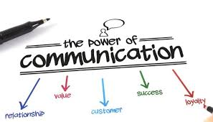

Slide 29


